Slide 1
Tech Time
A discussion and Q&A about Tech for HRG

Slide 2
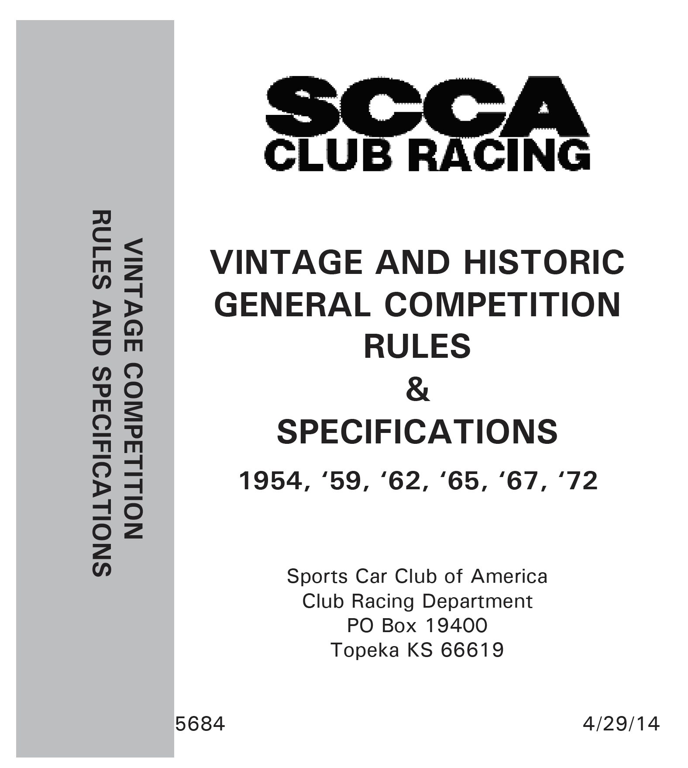
What’s it all about, Alfa?
Tech is about getting you on track and home again, safely.
Reference materials
GCR & Vintage GCR
Both available at (SCCA.com – Programs – Road Racing – Rules)
https://www.scca.com/pages/cars-and-rules.
GCR sections 9.3 and 9.4
Equipment Manufacturer’s Installation and Use instructions
Common Sense

Slide 3
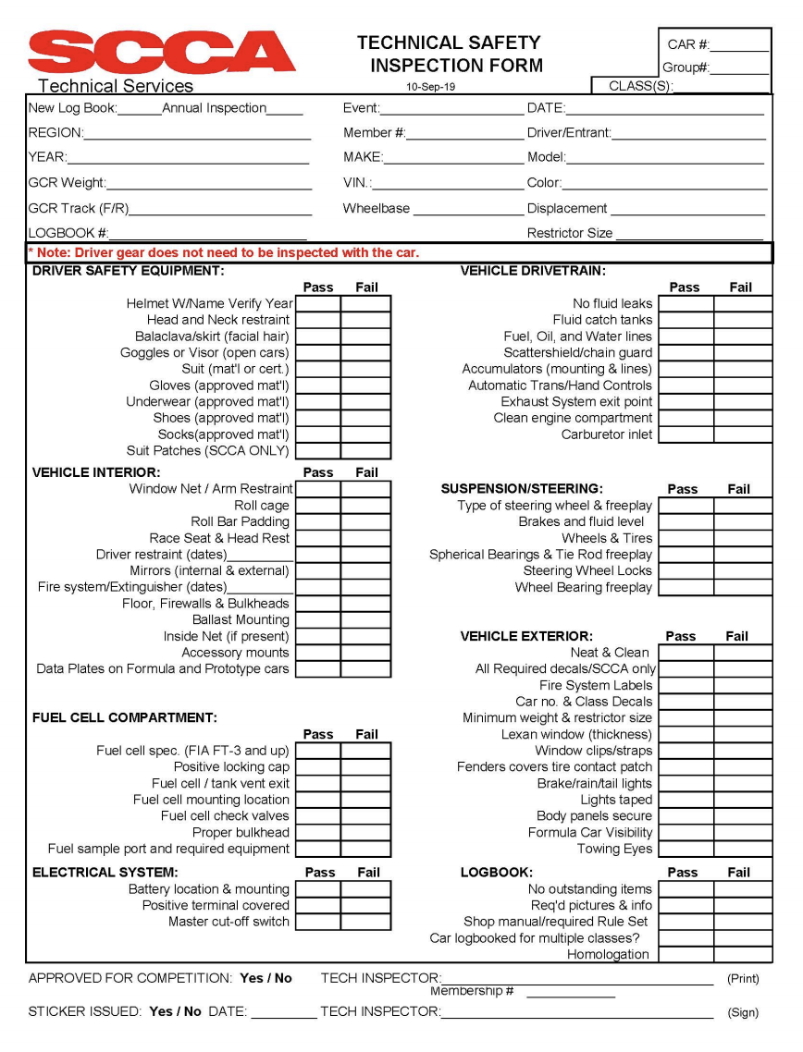
Checklist
This handy checklist can help you make sure your car is ready for tech and track.
Expect it to be available:
SCCA.com/roadracing and then click on Rules in the Road Race section.
In the Technical Inspection Manual in your “file cabinet”
Copy this screen NOW!

Slide 4
Commonly Missed Items

Slide 5
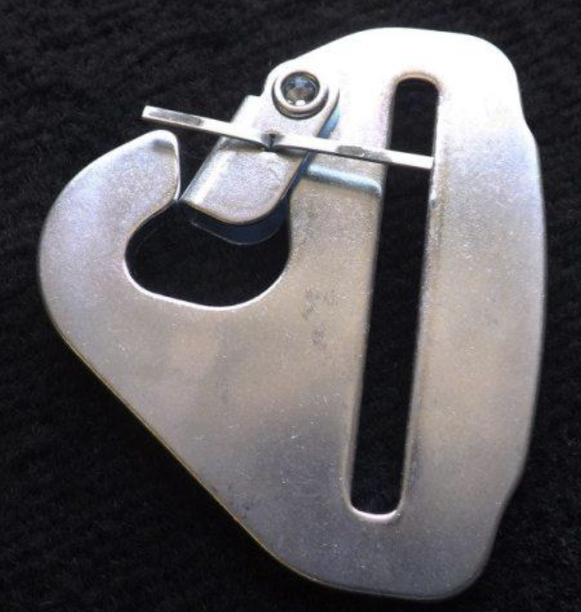
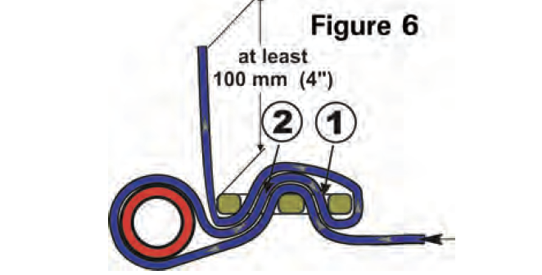
Cotter Pins and belt wrap
Courtesy of Schroth

Slide 6
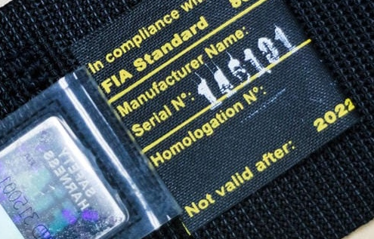
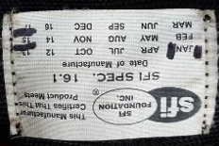
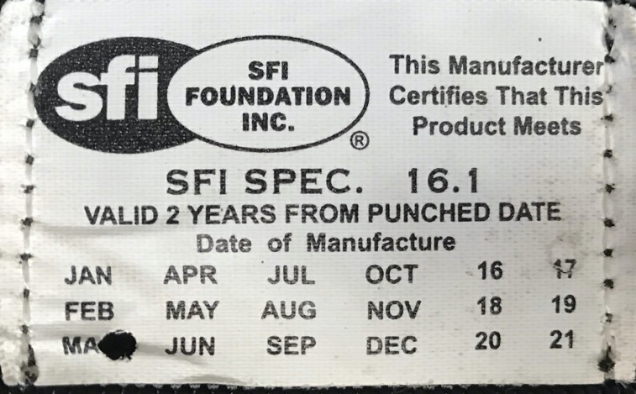
A Closer Look at Belts
FIA and SFI both certify belts
Both are acceptable
SCCA: Dec 31 of the year of Expiration
Expiration times can be different
FIA: 5-years from date of manufacture
SFI: It depends:
5-years if no date of expiration
2-years from date of manufacture if so stated
SCCA end of the second calendar year
SVRA and New Jersey: as stated on restraint
Some belt labels will have a “Not Valid After …” or “Valid Until …” date printed on them
As marked (5-YEARS)
5-YEARS
2-YEARS
As Marked

Slide 7
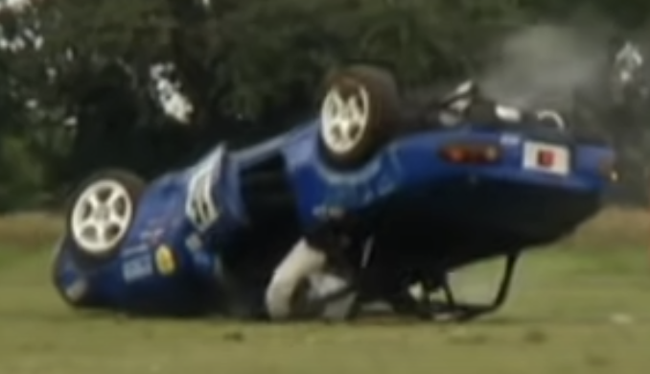
Arm Restraints & Window Nets
Reduce the possibility of rolling over your arms.
Window Nets
Must meet SFI 27.1 (SVRA enforces the 2-year expiration date)
Must be mounted to drop down with release accessible to both driver and rescue worker
Arm restraints
Required in open cars and others where a window net cannot be mounted
Acceptable alternative to window nets for closed cars in SCCA vintage sanctioned races only
Preferred in VRG
Must meet SFI 3.3 for SVRA
SCCA and VRG have no such SFI requirement
https://www.youtube.com/watch?v=OfWjXzvVoL0

Slide 9
Batteries Not Tied Down and/or Insulated
Wet-cell batteries relocated to the PAX must be in a marine-type container.
The only purpose of the container is to reduce acid splash onto the driver
The battery must be secured to the car independent of the container.
Lateral motion control as well as vertical hold down is a very very good idea, as are metal hold downs.

Slide 10
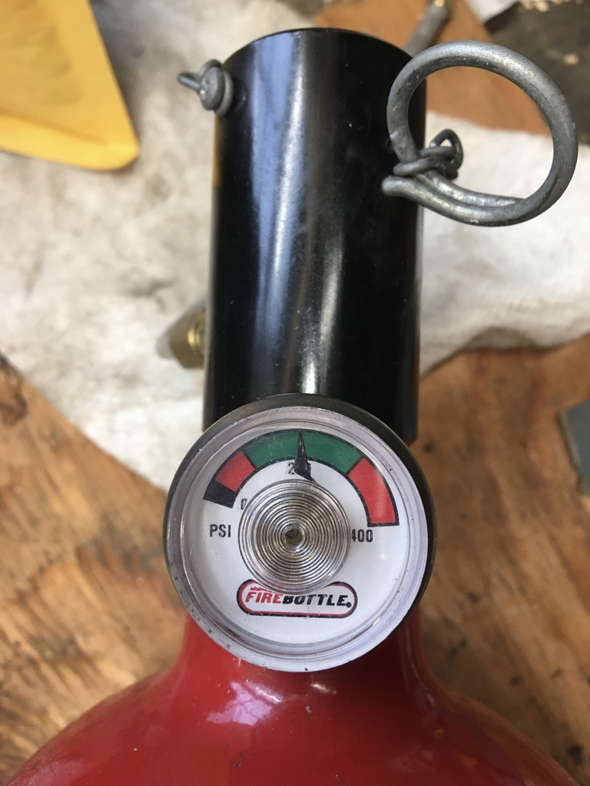
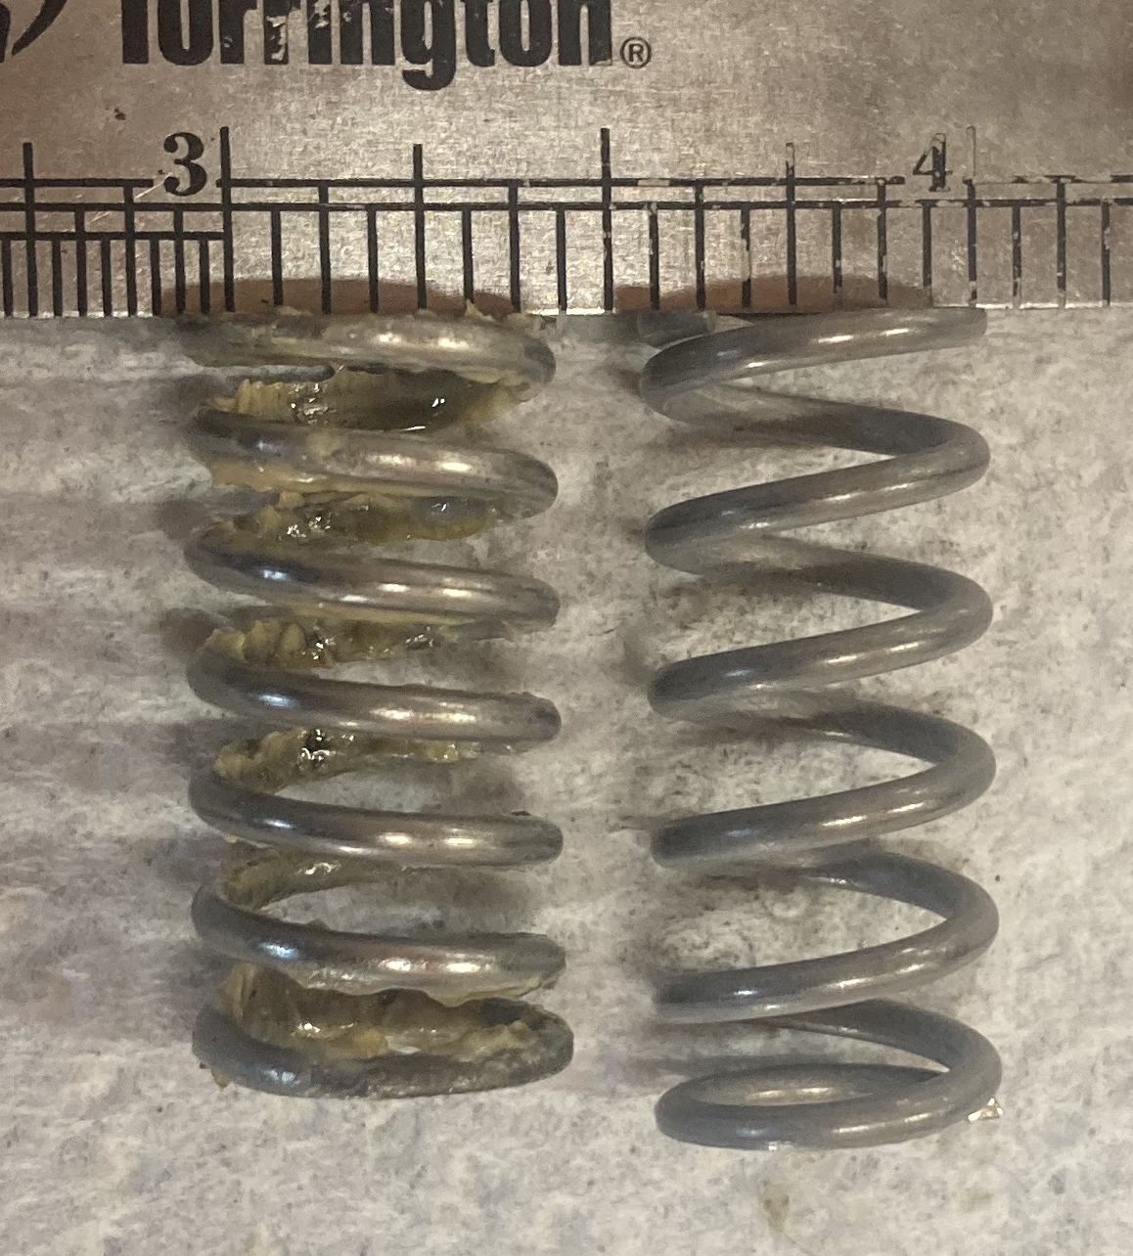
Fire systems Not Maintained
It is required that your fire system be maintained per the manufacturers’ instructions
Actuating heads lubed
Actuating springs replaced
Safety pins on the bottle and actuating handle pulled before going on track!!!!
Handheld Fire Bottles should be replaced every 12 years per several manufacturers
Used New

Slide 11
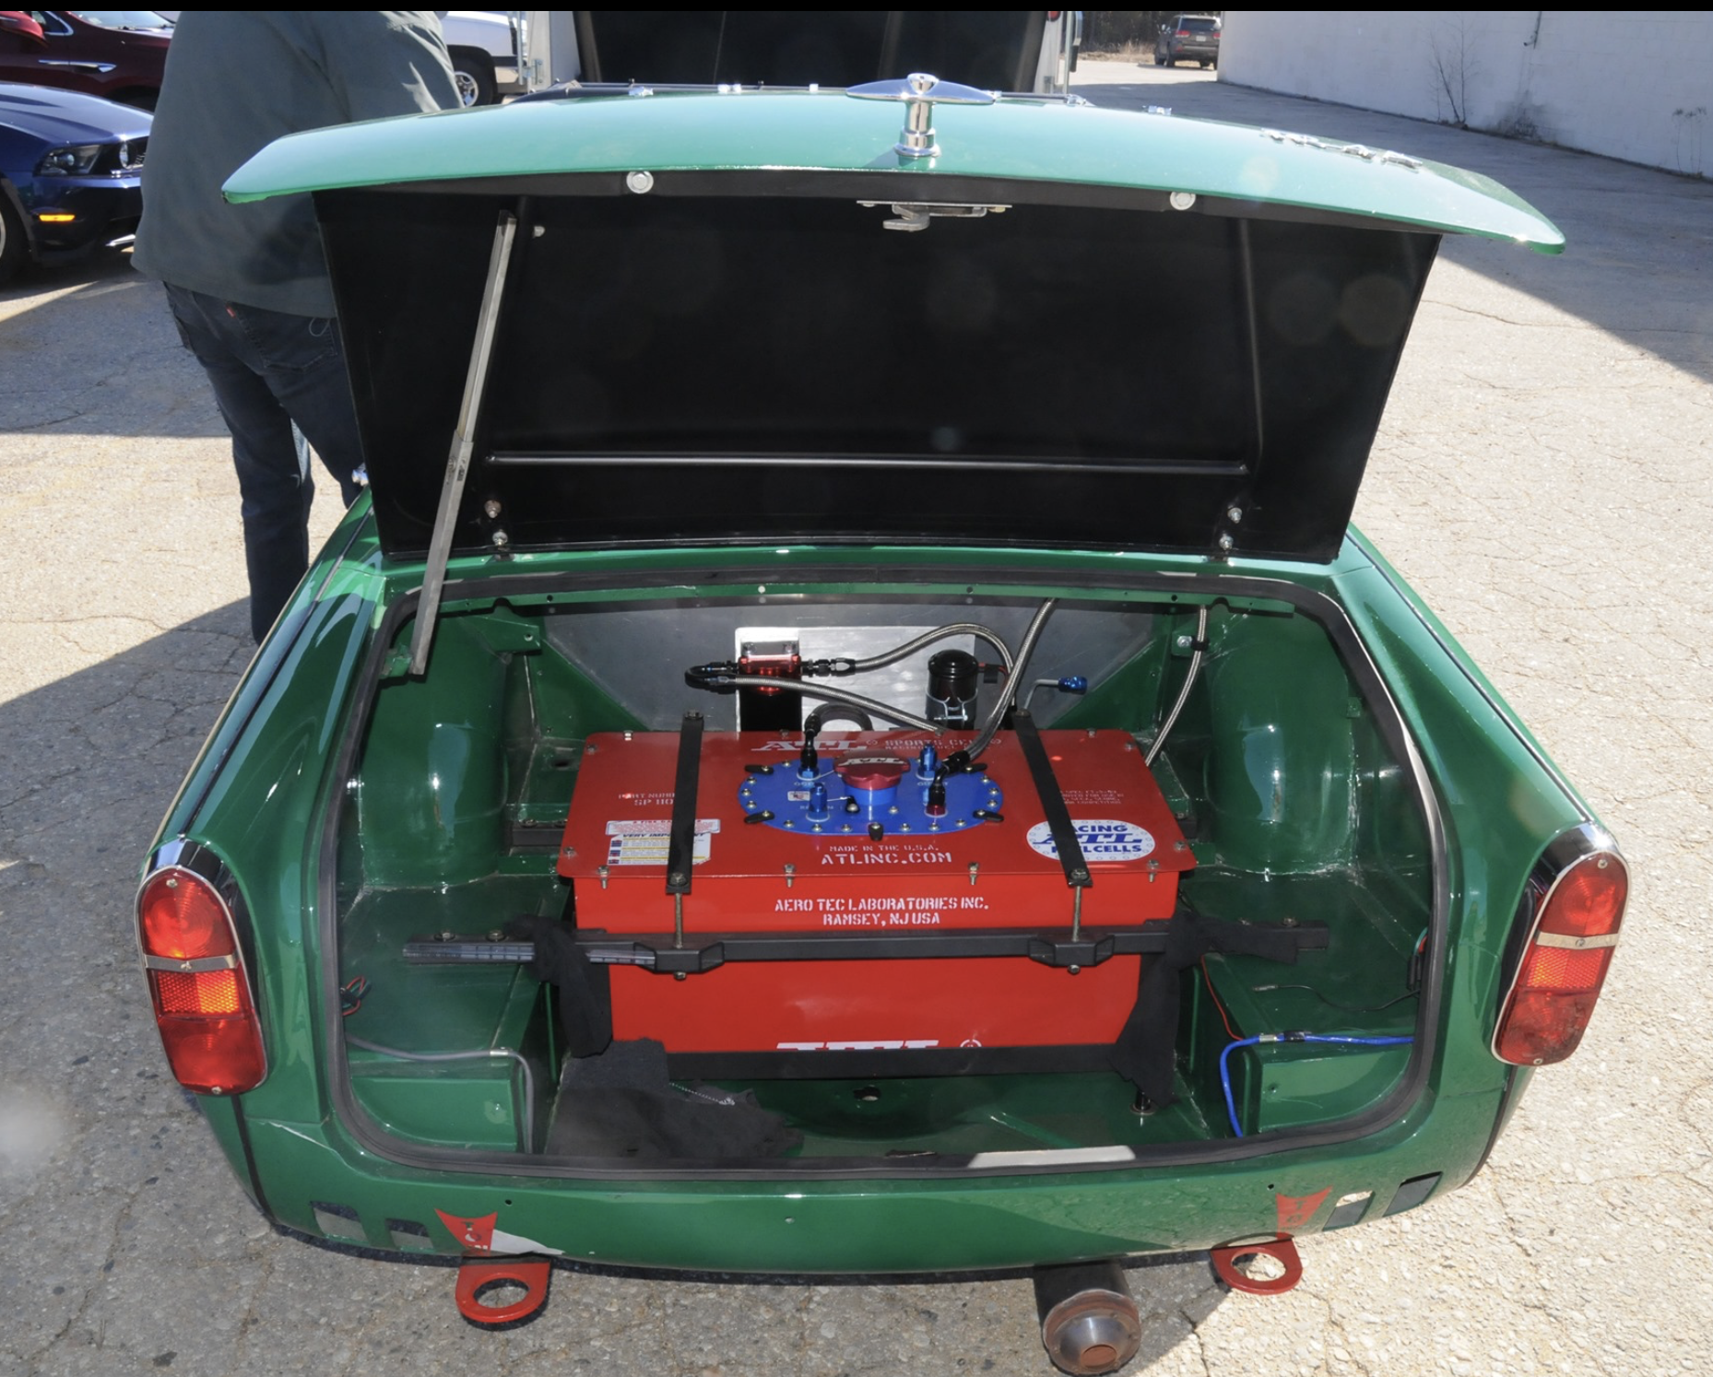
What times out?
SCCA enforces dates on
Belts
Helmets
Some other race organizations also enforce dates on
HANS devices
Window nets
Time takes its toll on fuel cells
ATL recommends
New foam every year
New bladders after 5 years
James Ray

Slide 12
Get that log book!
When buying a new-to-you vintage race car, be sure to get the original log book.
The date of issuance establishes the acceptable era of the roll cage and certain other safety equipment.
Roll cage
Fuel cell
If this is not available, then the cage and fuel cell must meet the current specifications in the GCR
An alternative is to use the log book from another VMC sanctioning body (VRG, SVRA, etc.) provided that the safety equipment reasonably conforms to date-of-issue SCCA specs. This will allow participation in Vintage Sanctioned SCCA events.

Slide 13
Q & A
SCCA Tech Inspector

